Slide 1
Visual Studio Team Services & GIT

Slide 2
What I am covering (and what I am not)
This is a ‘How to use Git from with Visual Studio’ session
ALM Rangers Version Control Guide http://vsarbranchingguide.codeplex.com/
Map TFVC actions to Git https://www.visualstudio.com/en-us/articles/mapping-my-tfvc-actions-to-git
Can also watch https://channel9.msdn.com/Events/Build/2015/3-746
Also recommended http://www.pluralsight.com/courses/git-visual-studio-developers (If you have PluralSight access, remember you can get 200 free minutes as a trial)
This is not a detailed ‘deep dive’ Git tutorial
Look at https://www.atlassian.com/git/tutorials/setting-up-a-repository for a good walk through of command line and theory behind Git

Slide 3
Modern source-control approaches
Strengths
Best for
Centralized Version Control
(TFVC)
Server Workspaces
Scales to very large codebases
Fine level permission control
Allows usage monitoring
Large integrated codebases
Control and auditability over source code down to the file level
Local Workspaces
Offline editing support
Easy to edit files outside Visual Studio or Eclipse
Medium-sized integrated codebases
A balance of fine-grained control with reduced friction
Distributed
Version Control (Git)
Full offline experience
Complete repository with portable history
Simplified branching model
Modular codebases
Integrating with open source
Highly distributed teams

Slide 4
TFVC to Git Terminology Cheat Sheet
TFS Version Control | Git
Workspace | Repository (aka. “Repo”)
Get Latest (First time) | Clone
Get Latest (After first time) | Pull
Check in | Commit + Push
Check out | (just start typing)
Branch (are a set of folders) | Branch (are all in a single folder)
Merge | Merge
Code Review | “pull request”
Shelveset | Stash
Label | Tag

Slide 5
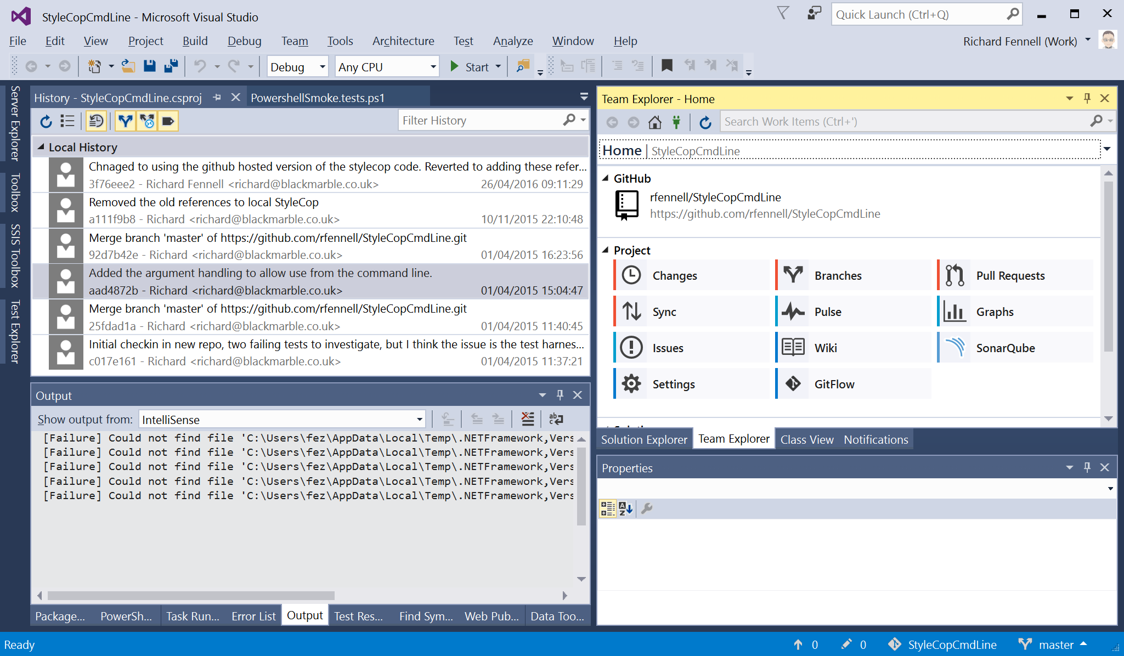
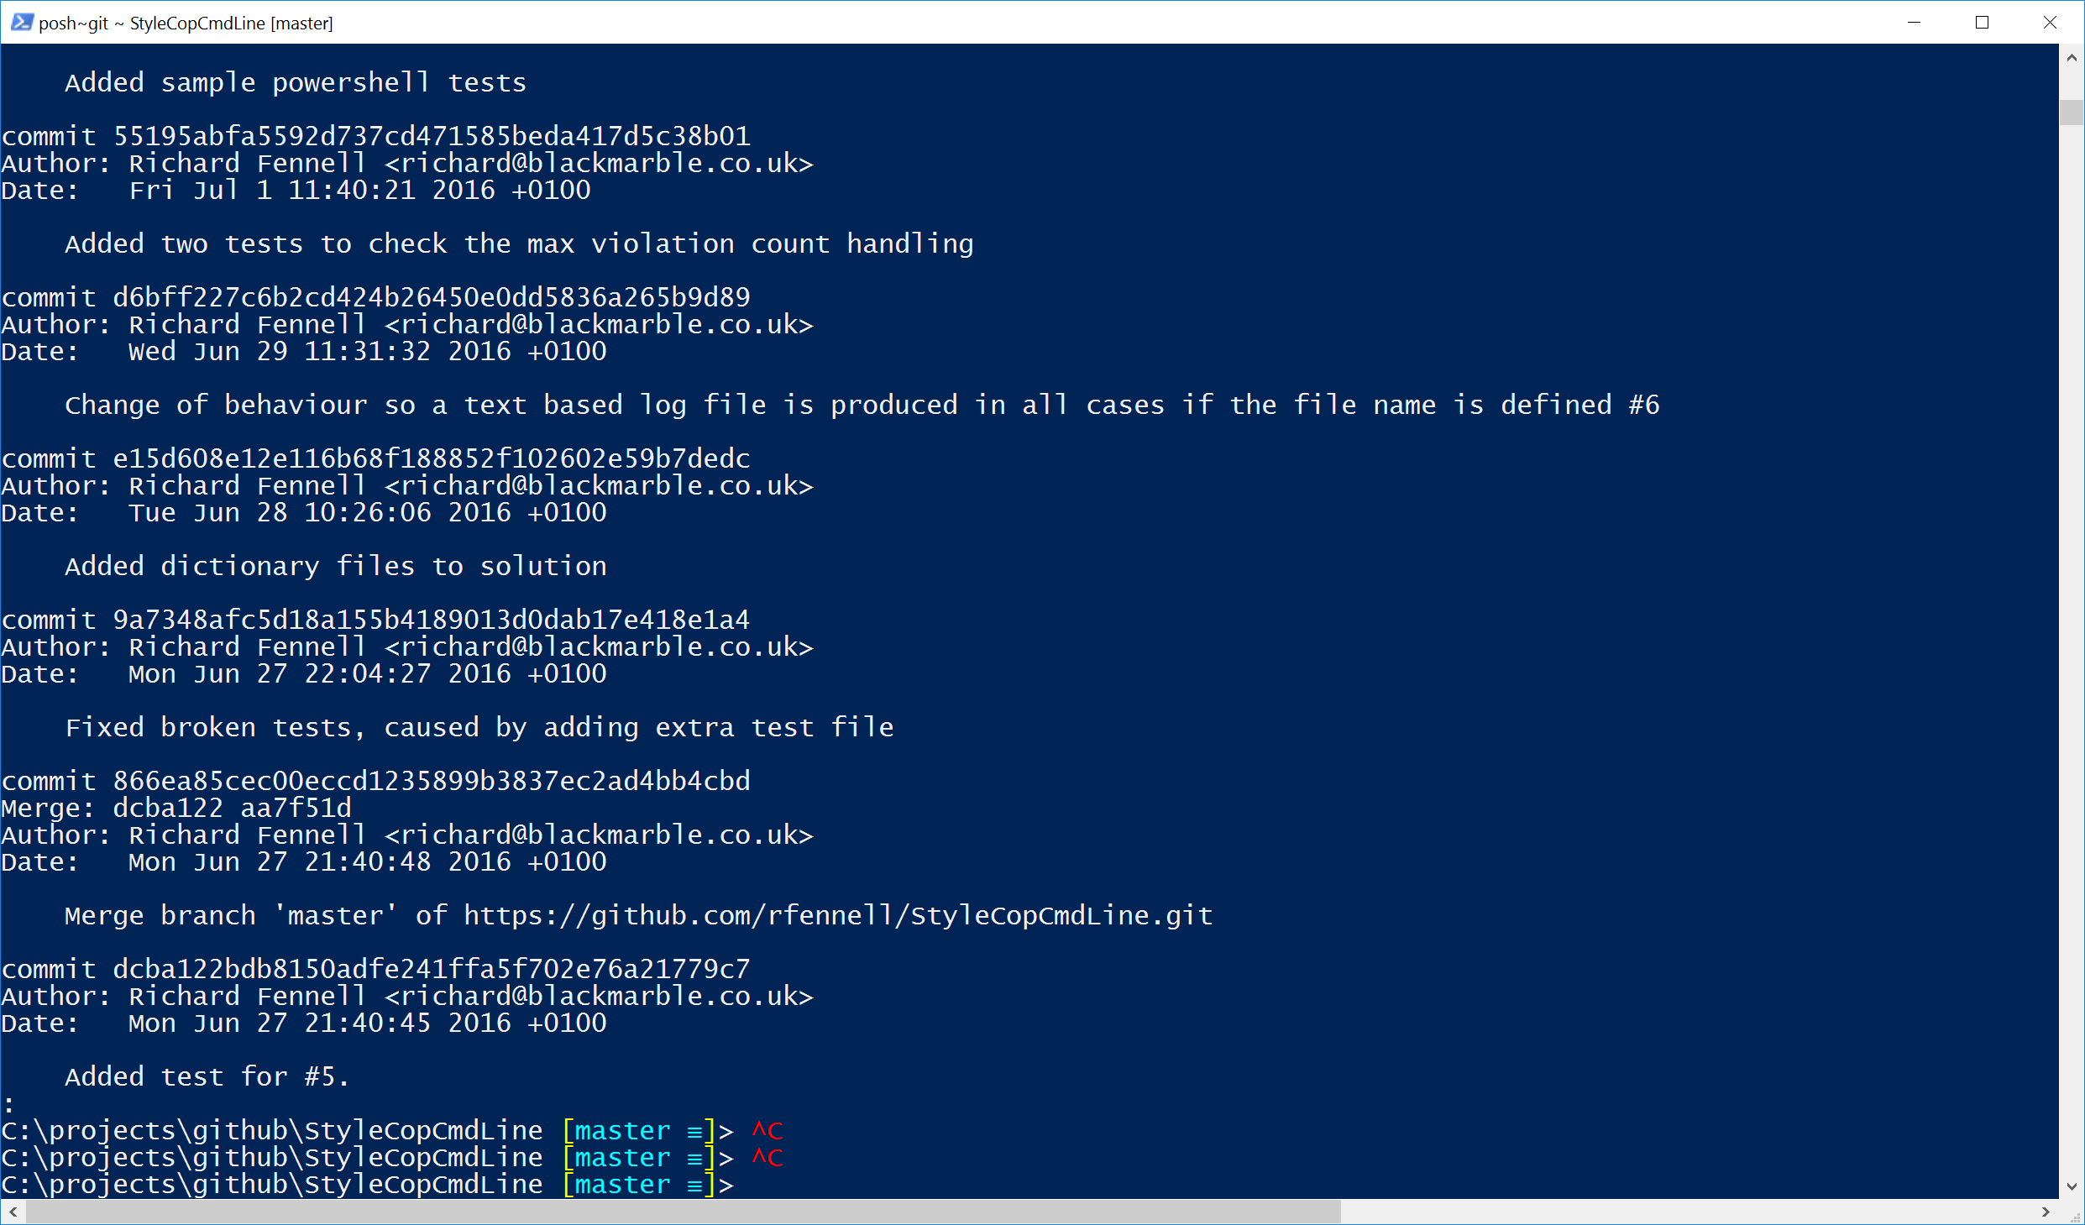
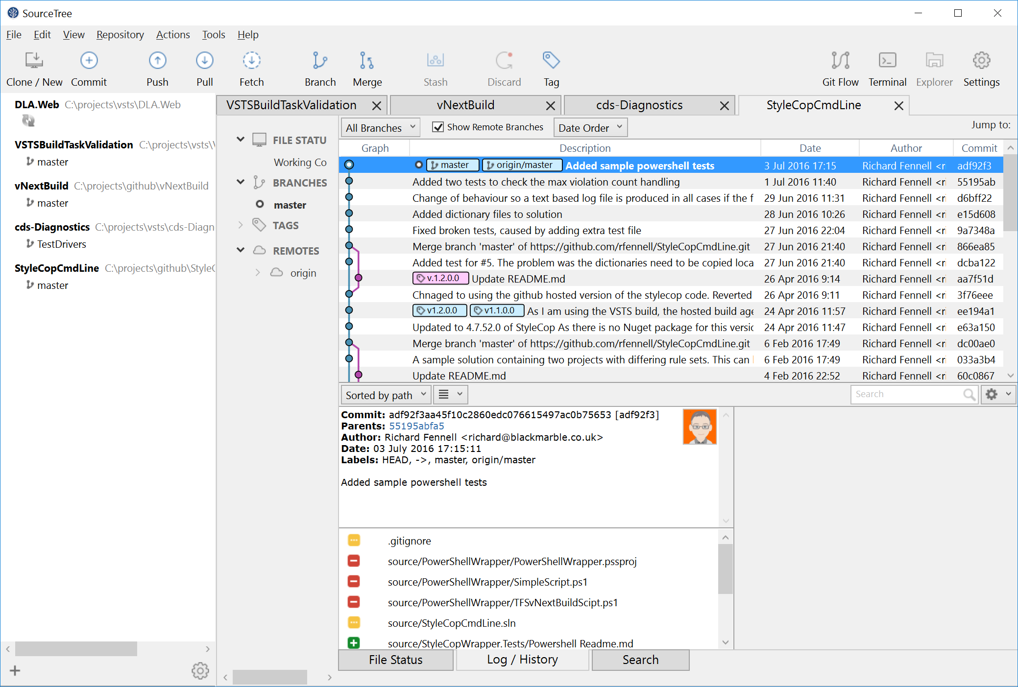
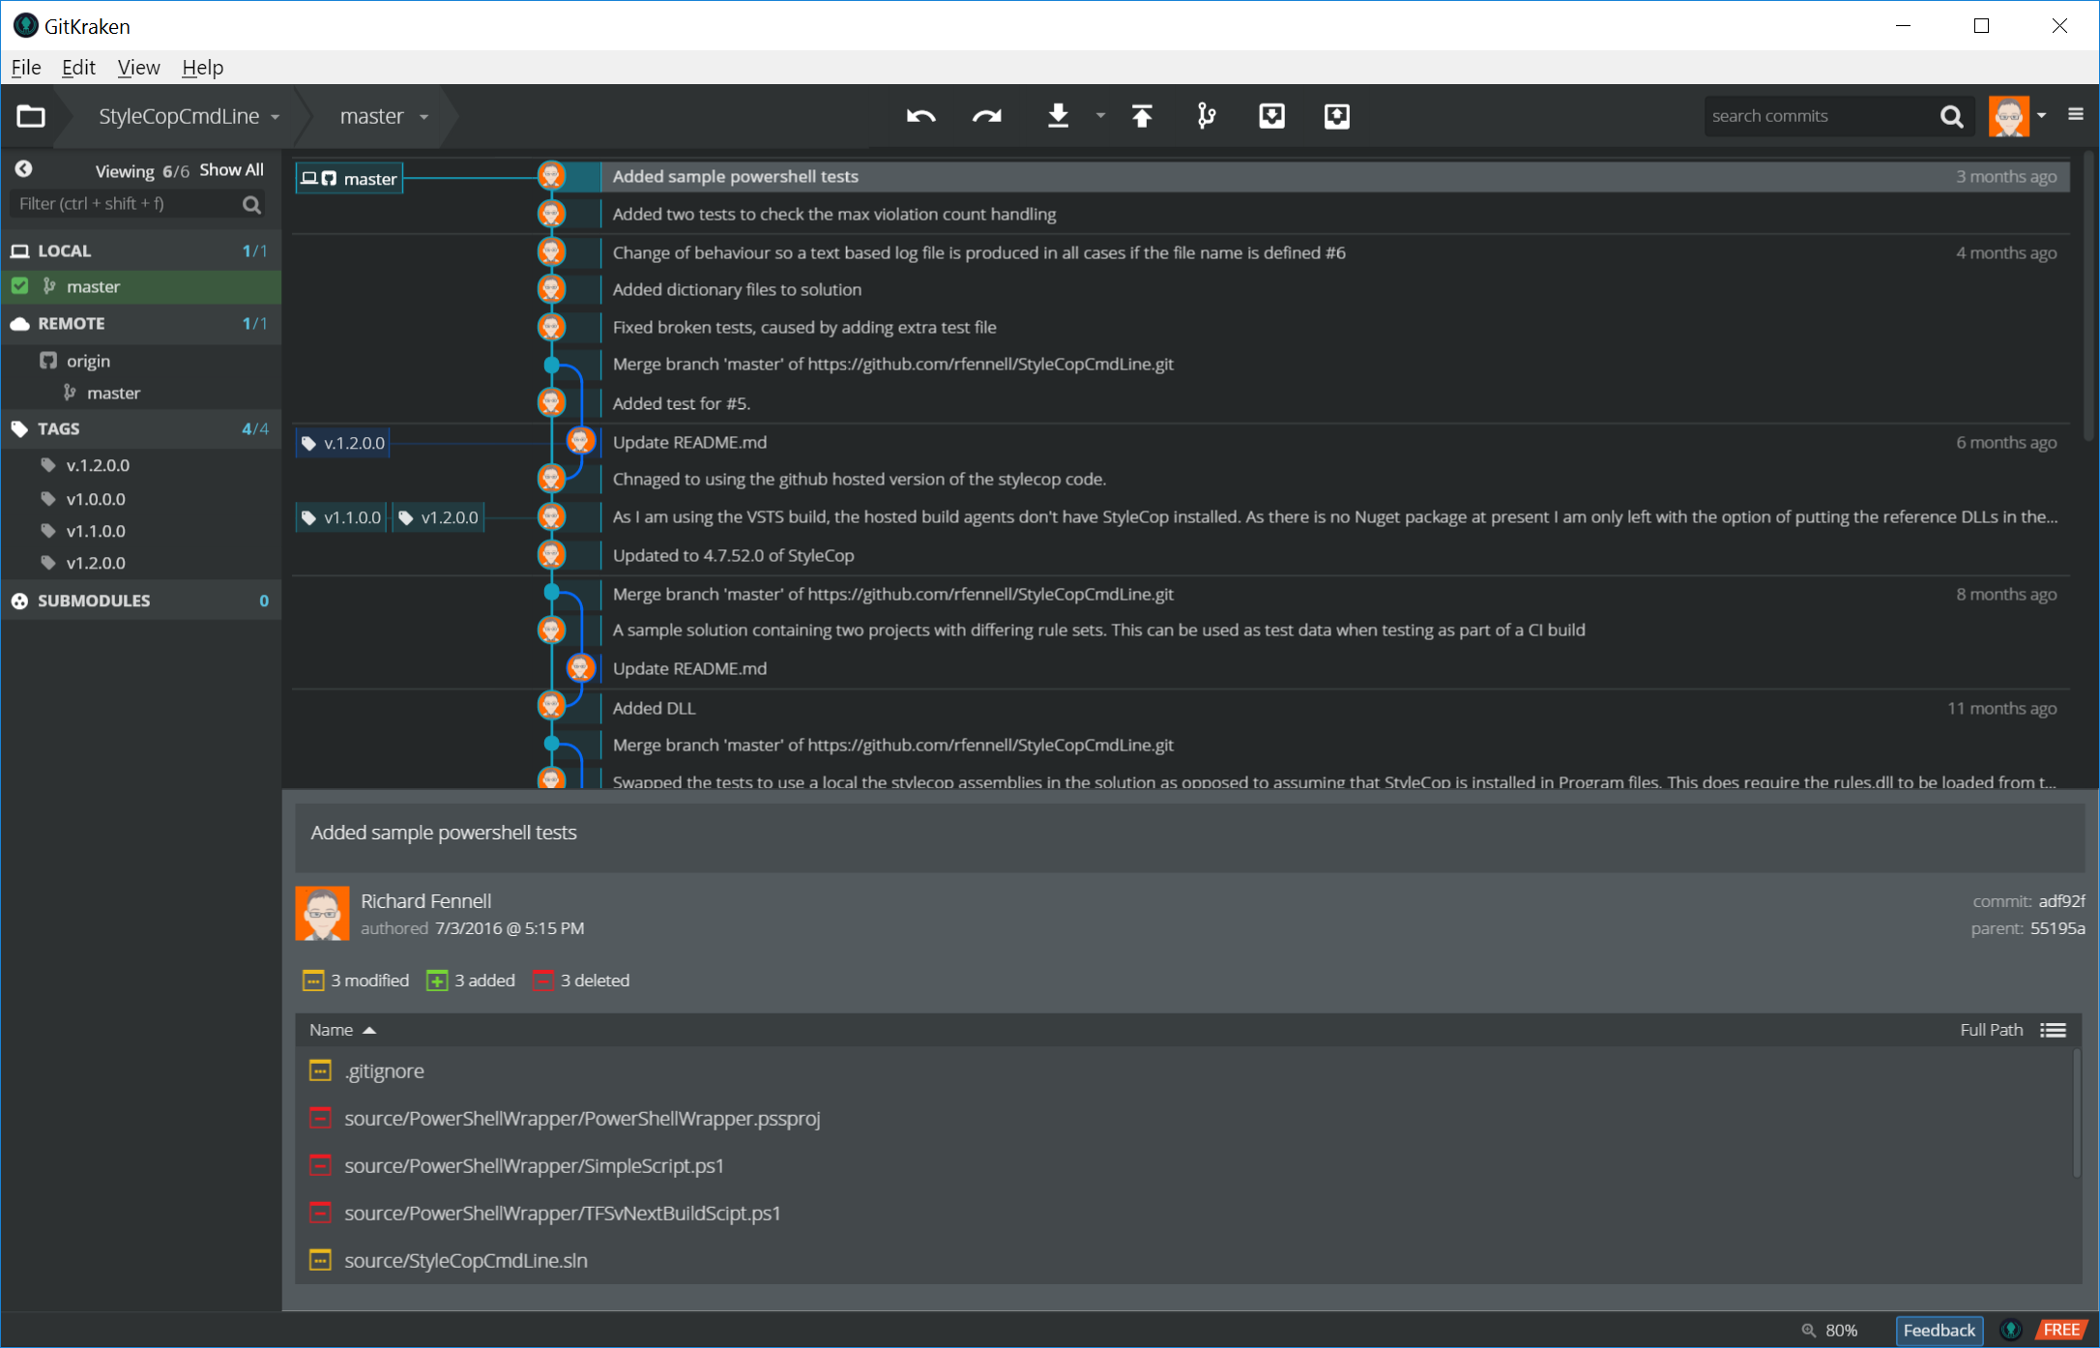
There are many GIT Clients
Notes:
As well as Visual Studio
POSH Git - https://github.com/dahlbyk/posh-git (Free)
SourceTree - https://www.sourcetreeapp.com/ (Free)
GitKraken - https://www.gitkraken.com/ (Free for personal use, then starts at $60/year for a single license)
Can add Git to Windows explorer using a variety of tools some built into Git basic product or Tortoise Git
And there are plenty more, most modern IDEs support Git directly
Key point is they can all work together on the same Git repo

Slide 6
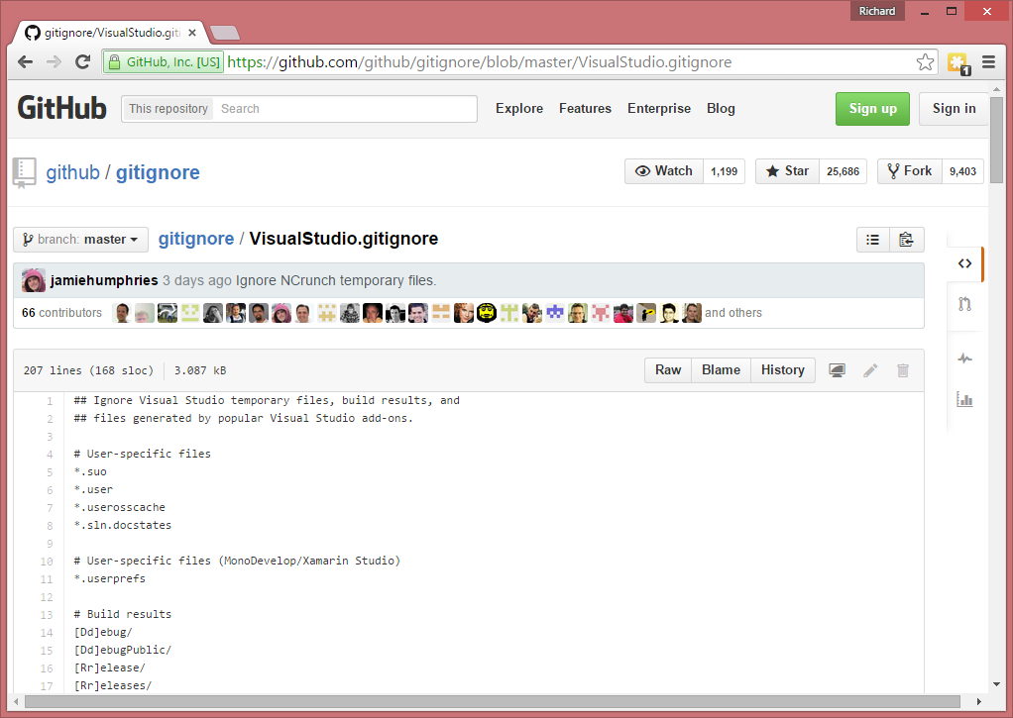
Controlling which files to source control
Notes:
Visual Studio will automatically add a .gitignore file for new solutions in a repo
If you are moving existing code then you can drop your own in. There is a huge library of them on Github for most languages and IDEs

Slide 7
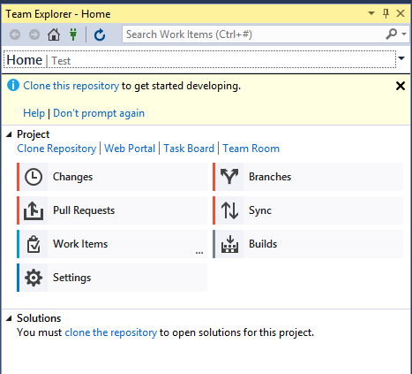
Connecting to a Git Repo in Visual Studio
Connecting to VSTS via Team Explorer (just like TFVC)
Clone a repository to make a local copy
Notes:
Demo – Assumes a VSTS Git Repo exists
Open VS
Open Team Tab
Select Manage Connections
Connect to VSTS instance
Select Team Project (noting can have many repos)
When given the open clone to a local folder – stress that this is a copy

Slide 8
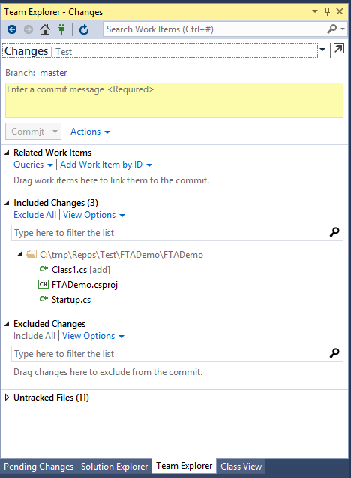
Day to Day Operations
Adding code (staging files)
Commit to the local repo
Sync to a remote repo
Fetch – a get from remote repo
Pull – a ‘fetch’ followed by a ‘merge’
Push – a push to a remote repo
View History
Reset to bring a branch in your local repository back to the contents of a previous commit
Revert to undo the changes made in your commits pushed to shared branches
Notes:
Need to demo all of the these steps, remember that we can do all the same things (and more) from the command line or GUI tools
https://www.visualstudio.com/en-us/docs/git/gitquickstart

Slide 9
Demo
Basic Operations

Slide 10
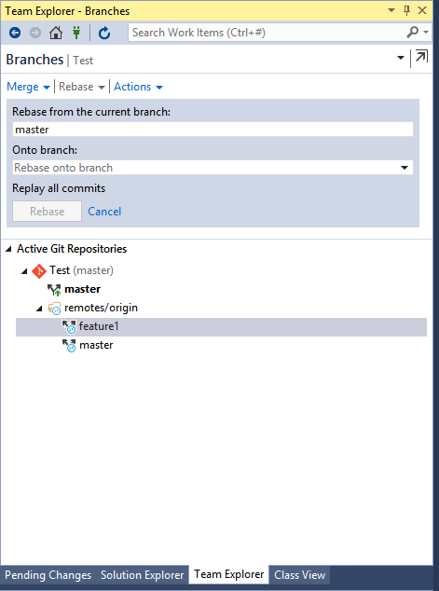
Branchingis different in GIT
Can branch locally
Can publish local branches to the remote ‘origin’ repo
VS 2012/13 offers merge
VS 2015/17 offers more merge/rebase options
There are always command line tools for other scenarios

Slide 11
Merges
HEAD
Merging two commits
mine
4d2460a
6d36faa
aab6f14
8b58f71
fc1de8e
bobs

Slide 12
Merges
HEAD
Merging two commits
mine
4d2460a
6d36faa
aab6f14
8b58f71
833831f
fc1de8e
bobs

Slide 13
Merges
HEAD
Fast-forwards
master
4d2460a
6d36faa
aab6f14
fc1de8e
feature

Slide 14
Merges
HEAD
Fast-forwards
master
4d2460a
6d36faa
aab6f14
fc1de8e
feature

Slide 15
Rebase
HEAD
Rebasing a commit
mine
4d2460a
6d36faa
aab6f14
8b58f71
fc1de8e
fc1de8e
bob

Slide 16
Rebase
HEAD
Rebasing a commit
mine
4d2460a
6d36faa
aab6f14
8b58f71
9cd3f8e
4a1defe
bob

Slide 17
Rebase
HEAD
Rebasing a commit
mine
4d2460a
6d36faa
aab6f14
8b58f71
6cdf32a
b9d3fe1
bob

Slide 18
Demo
Branch Operations

Slide 19
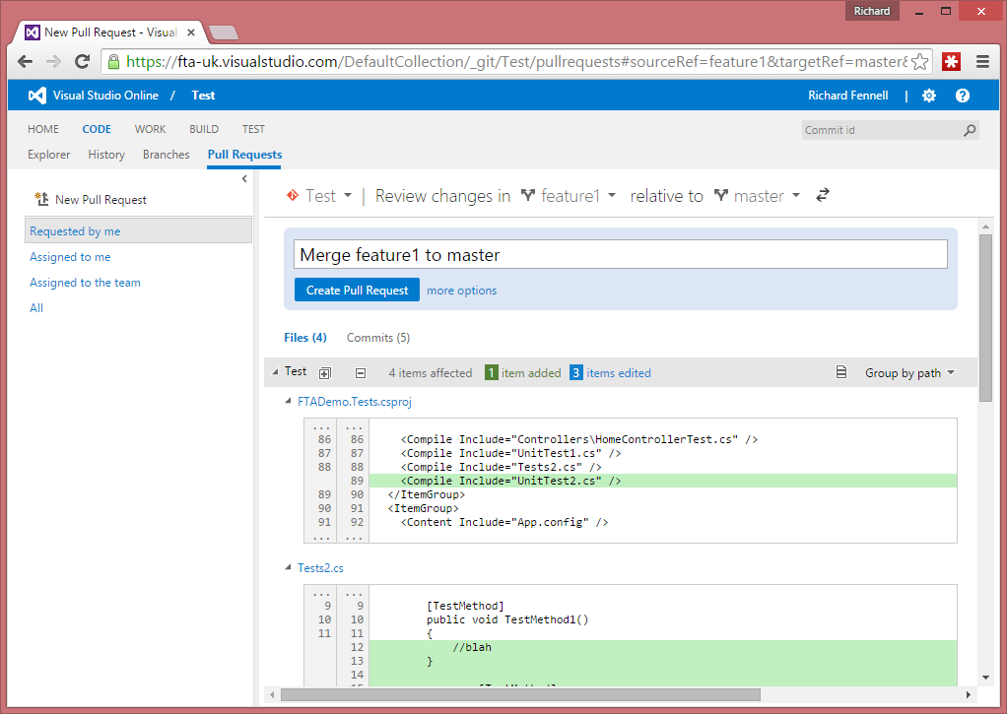
Pull Requests
Controls merging
Allows code reviews

Slide 20
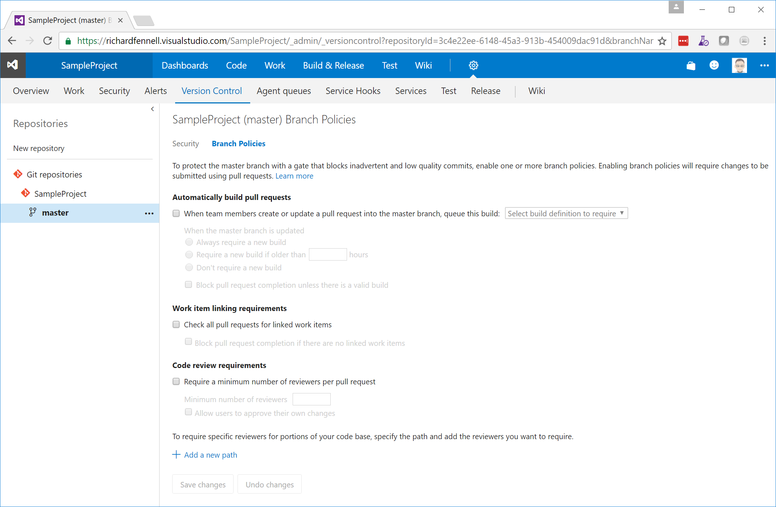
VSTS Branch Policies

Slide 21
Demo
Pull Requests

Slide 22
Gotcha’s
Weird Errors in Visual Studio Git tools
Use the git command line tools
Authentication outside of Visual Studio
Use SSH
https://www.visualstudio.com/da-dk/docs/git/use-ssh-keys-to-authenticate
(last resort) Use alternate credentials
https://www.visualstudio.com/en-us/integrate/get-started/auth/overview

Slide 23
What if I am using another IDE?
Most modern IDEs support Git today
For older ones look at the GIT extensions for Visual Studio
https://code.google.com/p/gitextensions/
Supports VS 2005 and later
Also installs command line tools (using MsysGit)
If doing a lot of command line look at POSH Git
https://github.com/dahlbyk/posh-git
TIP: Install it using https://chocolatey.org/ ‘choco install poshgit’

Slide 24
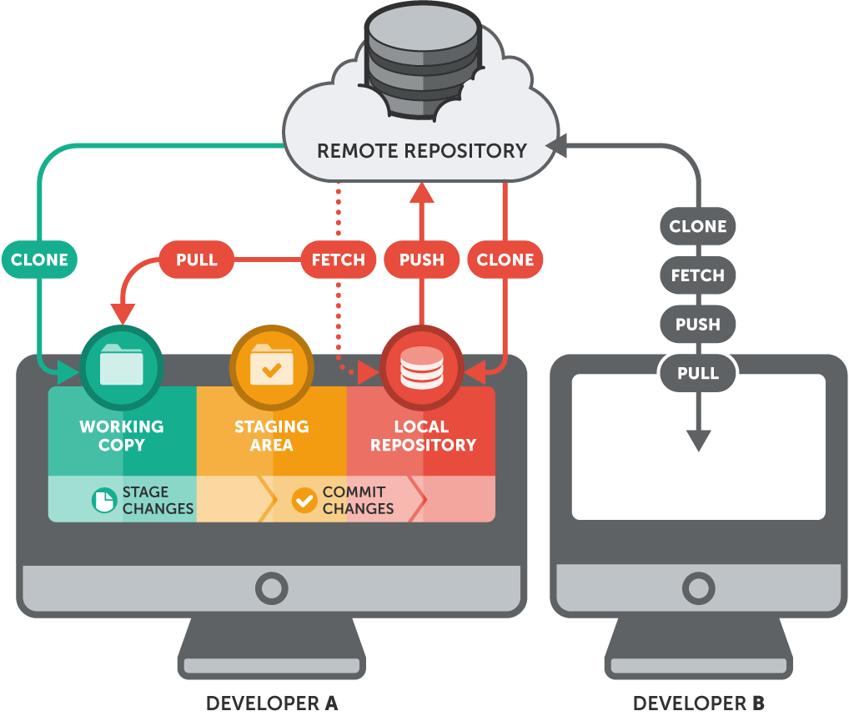
Quick Reference Summary
TFS Version Control | Git
Workspace | Repository (aka. “Repo”)
Get Latest (First time) | Clone
Get Latest (After first time) | Pull
Check in | Commit + Push
Check out | (just start typing)
Branch (are a set of folders) | Branch (are all in a single folder)
Merge | Merge
Code Review | “pull request”
Shelveset | Stash
Label | Tag
Image Source: https://www.git-tower.com/learn/git/ebook/en/command-line/remote-repositories/introduction

